Slide 1
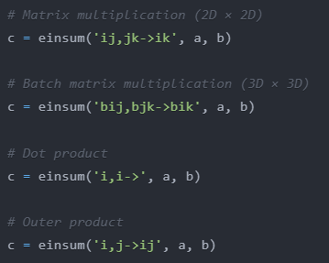
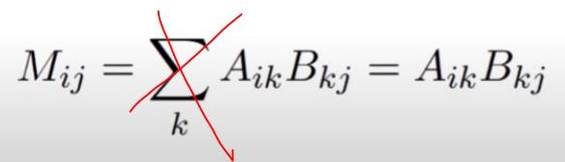
EinOps Whoopsydoopsy

Slide 2
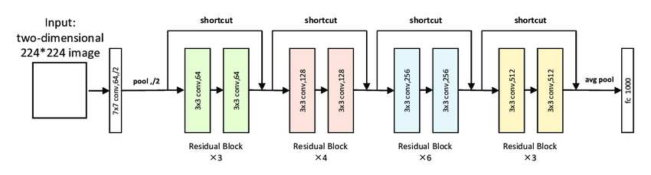
Implementing your own Neural Network
Explanation of building blocks

Slide 3
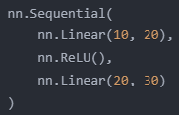
nn.Module
- The base class for all neural network components
- Allows you to organize layers and their parameters modularly
- Automatically tracks all parameters for optimization
- Must implement forward() method defining computation
nn.Parameter
- Special tensor that gets automatically tracked
- Used for learnable weights and biases
- Will be updated during backpropagation
Example:
Buffers:
-tracked by the model, part of statedict
-not updated by the optimizer
-Example:
nn.Sequential
Container to stack modules in sequence
- Automatically chains forward() calls
- Useful for linear architectures
- Example:

Slide 4
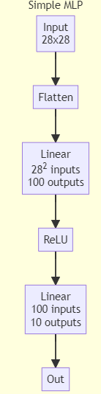
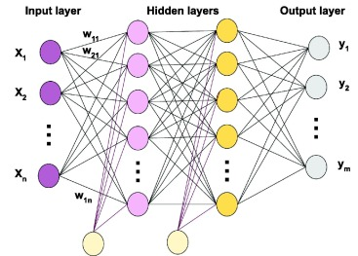
Multyilayer Perceptron
The classic simplest neural network
A stack of fully connected layers with activation functions
No sense of space in the neural network structure
Works with any kind of data
Also, still part of Transformer architecture

Slide 5
Convolution
You can make use of the “local” structure of the image
An “edge detector” (for example)acts the same on parts of the image

Slide 6
Convolution - stride
You can give the image, as it passes through the network, lower resolution, by skipping steps
Here, no pixel gets completely lost

Slide 7
Convolution - padding
Pixels on the border of the image get viewed only once, image gets smaller
Image gets smaller without stride
Add “empty” pixels outside the image to cancel this effect

Slide 8
Convolution - channels
Typically, you have more then one convolution kernel active at once
This leads to an additional output dimension per picture: channel
Example: Colour or different features like different edges/objects

Slide 9
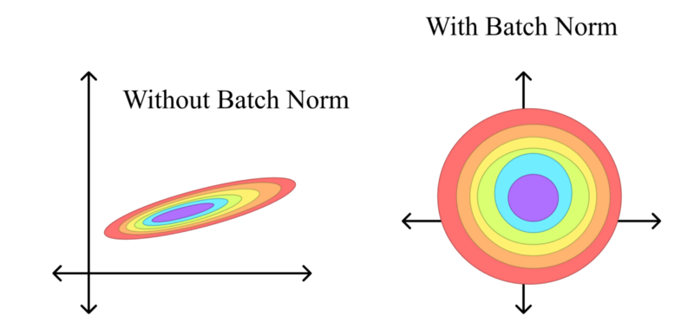
Batch Norm
The value of the activation is less important then its relative size
Example: brightness in an image / across images
Normalize distribution

Slide 10

Batch Norm– how this gets calculated
Learnable parameters
In Training: Updated as a rolling average
In Deployment: Frozen
Activations: For taking activation statistics, all activations from the same channel are taken as draws from the same distribution (independent of location in picture)

Slide 11
MaxPooling (2d)
Reduce the size of the resulting Image
Taking the maximum of each kernel window
Example: Object detection in a part of the image

Slide 12
AveragePool
Reduce resulting image to a single number
Example: classifying an image with a single lable
Average over space dimensions

Slide 13
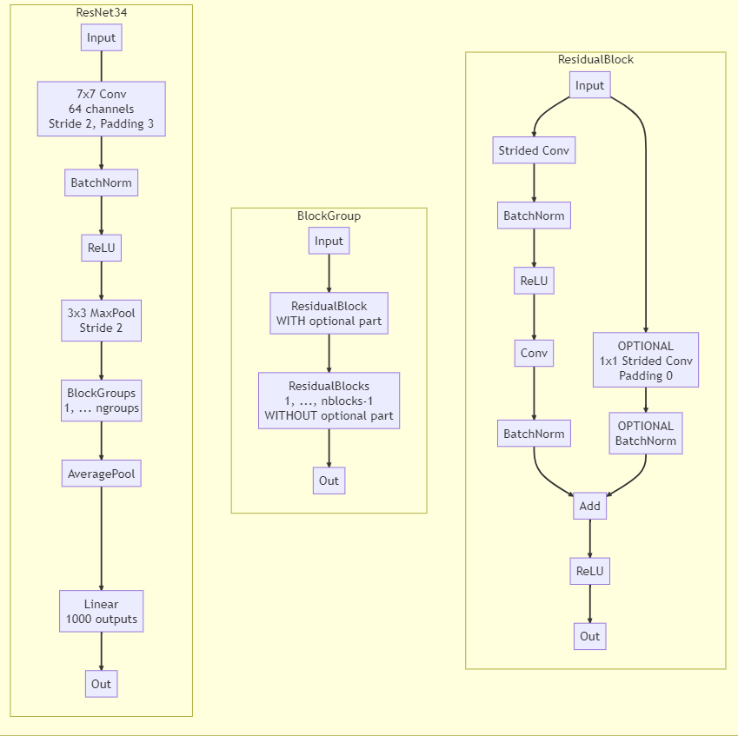
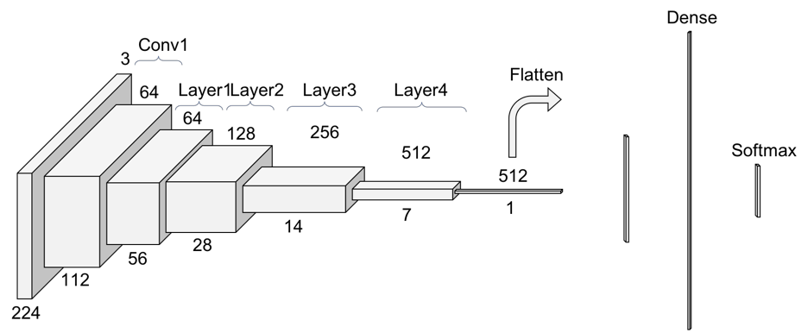
ResNet 34

